Slide 1
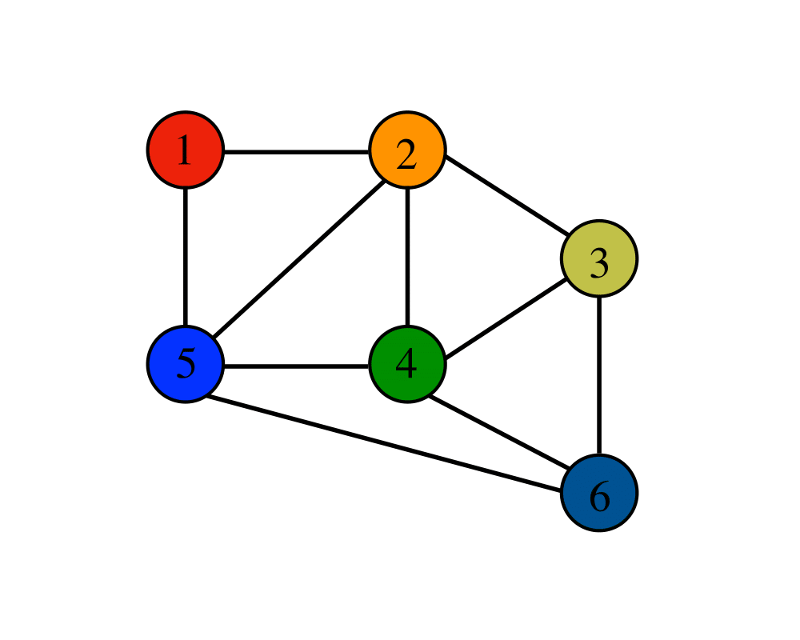
Graph
Notes:
NOTE:
To change the image on this slide, select the picture and delete it. Then click the Pictures icon in the placeholder to insert your own image.

Slide 2
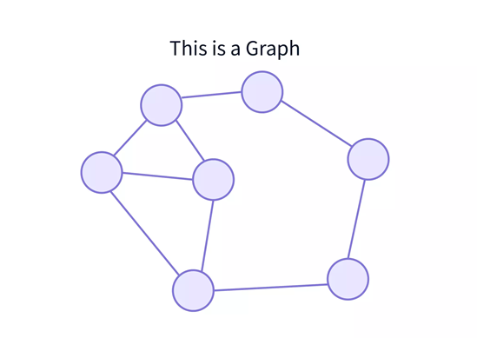
Definition
A Graph in Data Structure is a non-linear data structure that consists of nodes and edges which connects them.
A Graph in Data Structure is a collection of nodes that consists of data and are connected to other nodes of the graph.

Slide 3
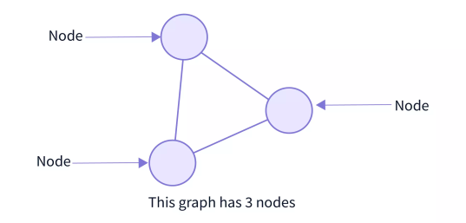
Graph Terminologies
Nodes/Vertices:
Vertices are the fundamental units of the graph.
Every node/vertex can be labeled or unlabelled.
A node can represent anything such as any location, port, houses, buildings, landmarks, etc.

Slide 4
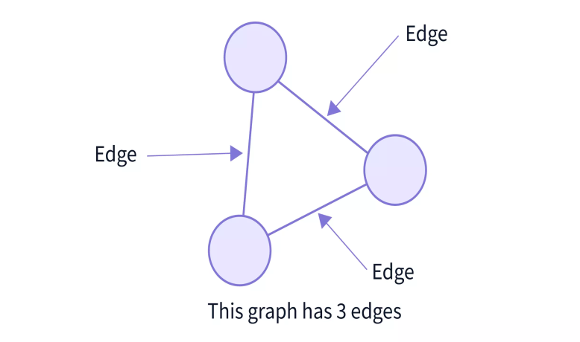
Graph Terminologies
Edges/Arcs:
Edges are drawn or used to connect two nodes of the graph.
It can be ordered pair of nodes in a directed graph.
Edges can connect any two nodes in any possible way. There are no rules.
Every edge can be labeled/unlabelled.

Slide 5
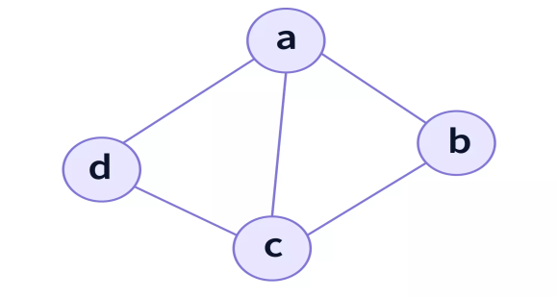
Graph Terminologies
A graph data structure (V,E) consists of:
A collection of vertices (V) or nodes.
A collection of edges (E) or path
OR
A graph is a pair of sets (V, E), where V is the set of vertices and E is the set of edges, connecting the pairs of vertices. In this graph:
V = {a, b, c, d}
E = {ab, ac, ad, bc, cd}
In this graph, |V| = 4 because there are four nodes (vertices) and, |E| = 5 because there are five edges (lines).

Slide 6
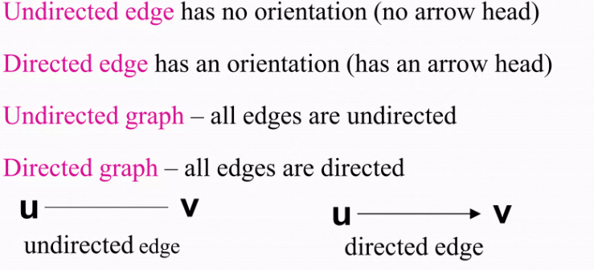
Graph Terminologies

Slide 7
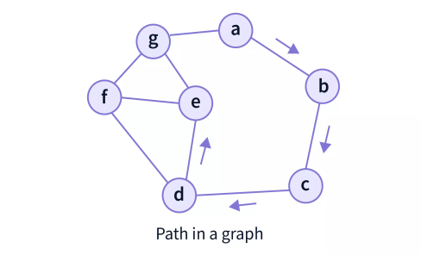
Graph Terminologies
Path: A sequence of vertices in which each vertex is adjacent to the next one
In the above graph, the path from 'a' to 'e' is = {a,b,c,d,e}
Adjacent vertices: Two vertices in a graph are said to be adjacent vertices (or neighbors) if there is a path of length 1 connecting them.

Slide 8
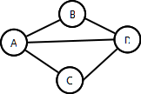
Degree of a Node
Cycle: a path that starts and ends on the same vertex
Simple path: a path that does not cross itself
That is, no vertex is repeated (except first and last)
Simple paths cannot contain cycles
A sequence of vertices: (A, B, C, D) [Is this path, simple path, cycle?]
(A, B, D, A, C) [path, simple path, cycle?]
(A, B, D, A, C) [path, simple path, cycle?]
Cycle: ?

Slide 9
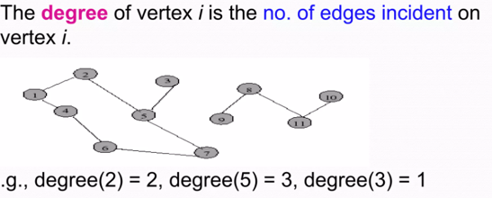
Graph Terminologies
Complete Graph: A graph in which every vertex is connected to every other vertex
Simple Graph: A graph which does not contain any loop or multiple edges
Multiple edges: Two nodes can be connected using more than 1 edges
Loop : an edge connects a vertex to itself

Slide 10
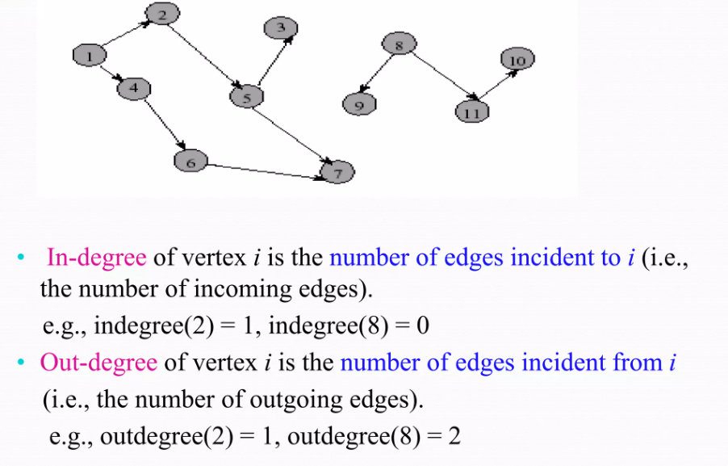
Graph Terminologies

Slide 11
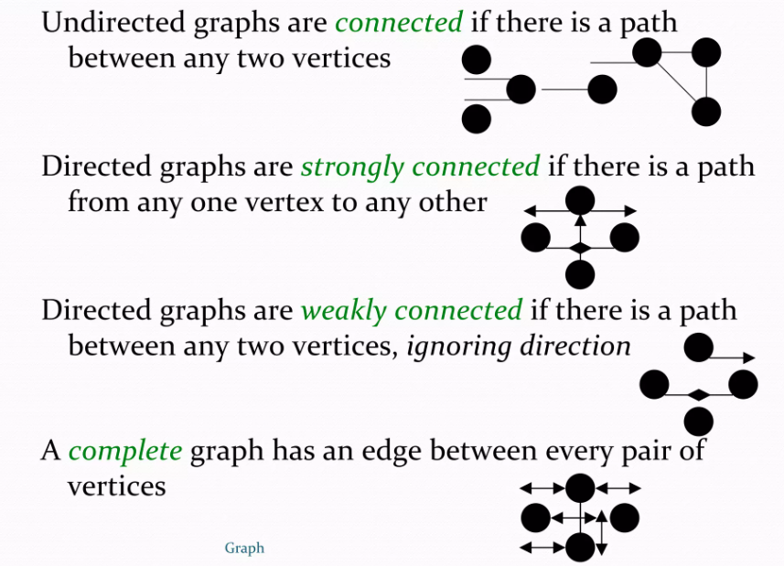
Graph Terminologies

Slide 12
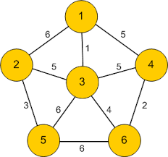
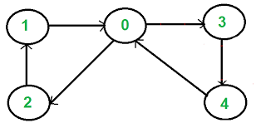
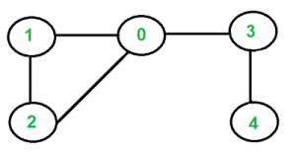
Types of Graph
Directed Graphs: Directed graphs in graph data structure are the graphs where the edges have directions from one node towards the other node.
Undirected Graphs: Undirected graphs have edges that do not have a direction. Hence, the graph can be traversed in either direction.
Weighted Graph: In weighted graphs, each edge has a value associated with them (called weight). It refers to a simple graph that has weighted edges. The weights are usually used to compute the shortest path in the graph.
Directed Graph
Undirected Graph
Weighted Graph

Slide 13
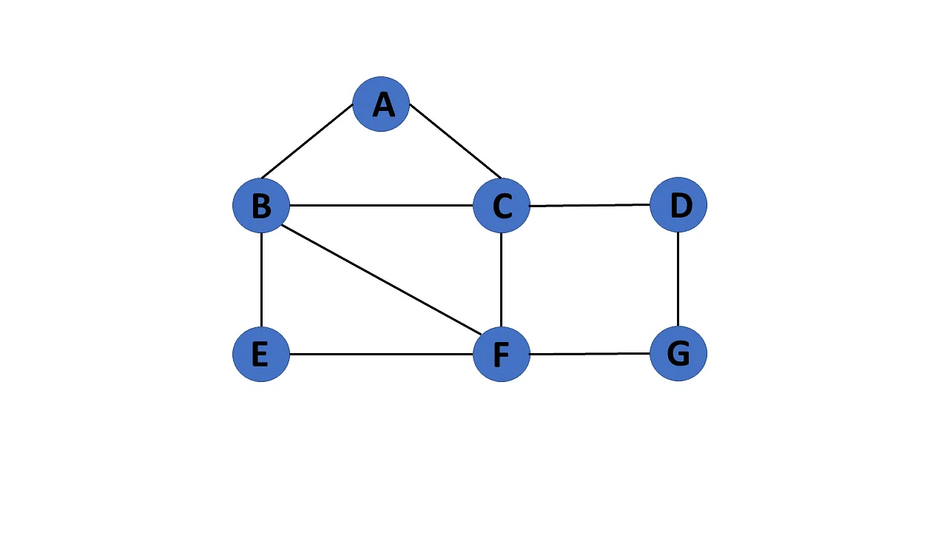
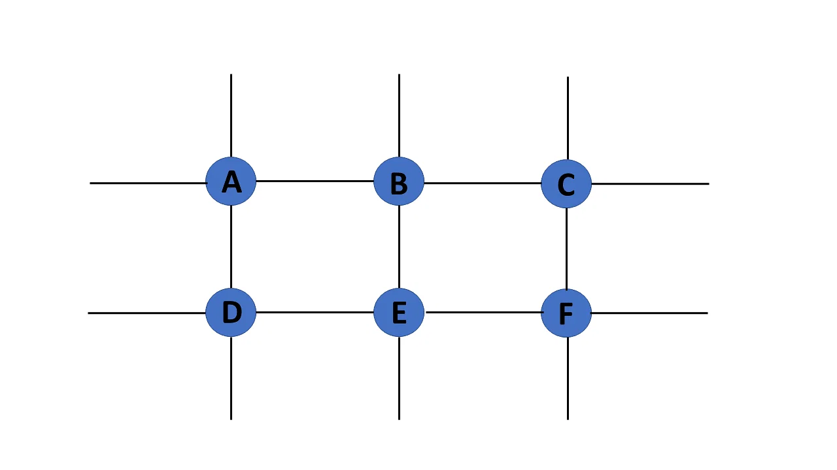
Types of Graph
Finite Graph: The graph G=(V, E) is called a finite graph if the number of vertices and edges in the graph is limited in number
Infinite Graph: The graph G=(V, E) is called a finite graph if the number of vertices and edges in the graph is interminable.

Slide 14
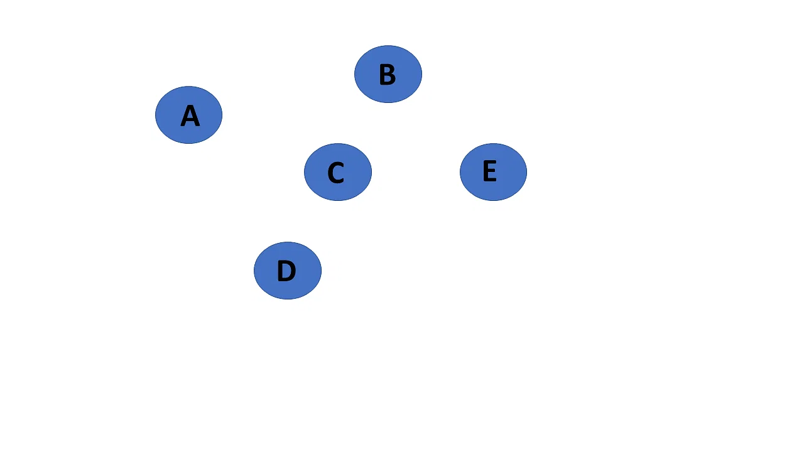
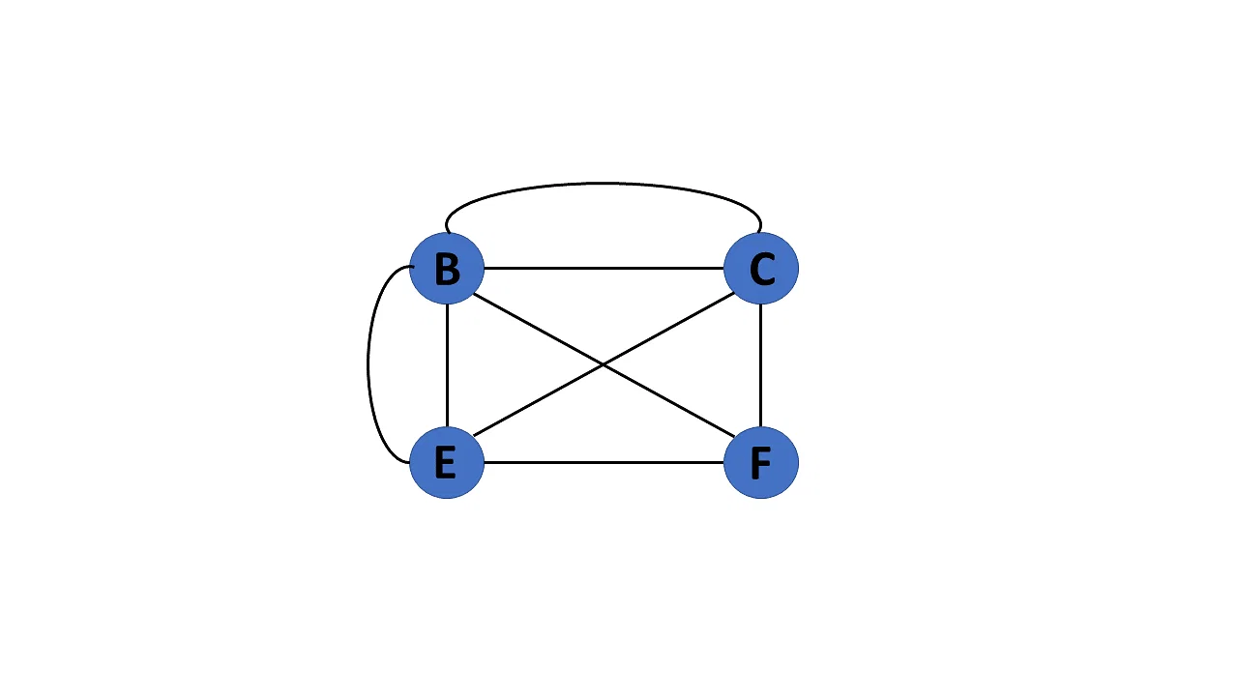
Types of Graph
Trivial Graph: A graph G= (V, E) is trivial if it contains only a single vertex and no edges.
Multi Graph: If there are numerous edges between a pair of vertices in a graph G= (V, E), the graph is referred to as a multigraph. There are no self-loops in a Multigraph.
Null Graph: It's a reworked version of a trivial graph. If several vertices but no edges connect them, a graph G= (V, E) is a null graph.

Slide 15
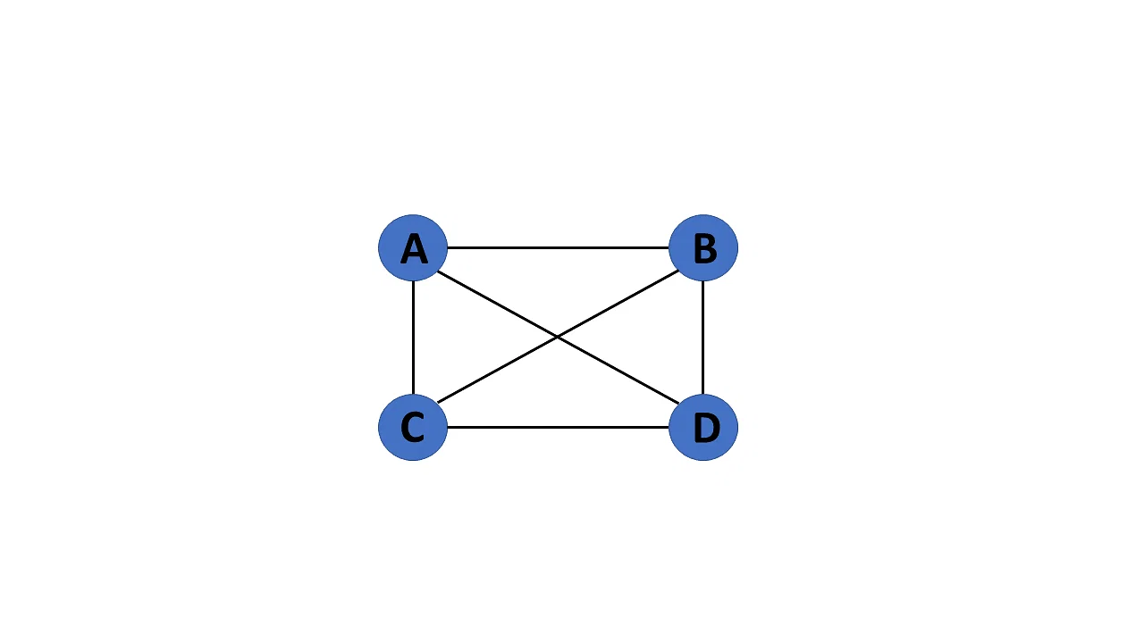
Types of Graph
Complete Graph: Every vertex is directly connected to every other vertex
Connected Graph: If there is a path between one vertex of a graph data structure to any other vertex, the graph is connected.

Slide 16
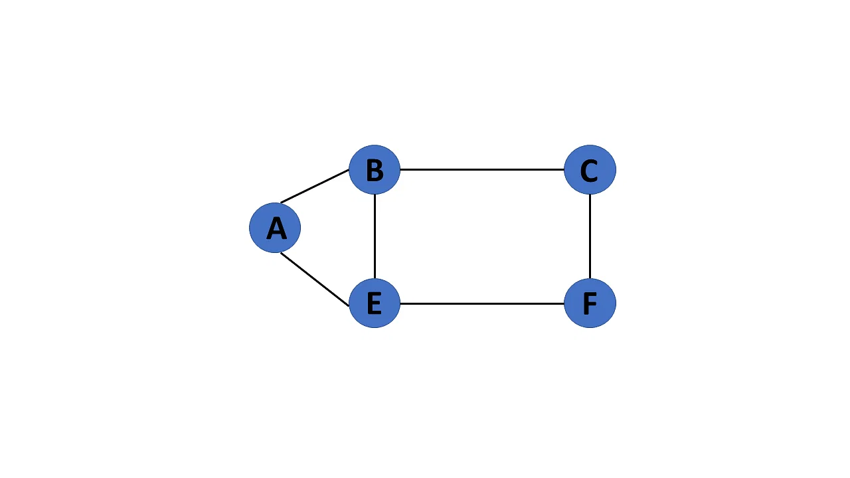
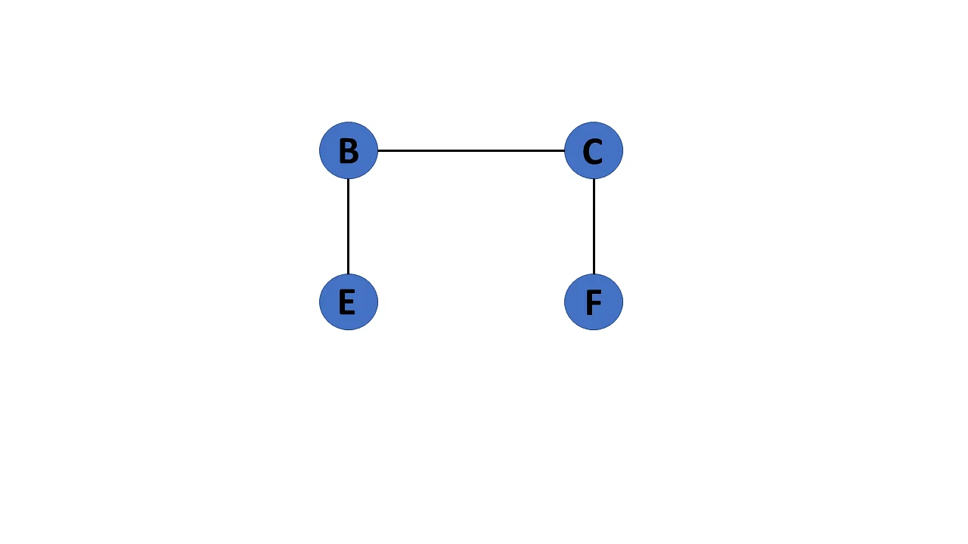
Types of Graph
Cyclic Graph: If a graph contains at least one graph cycle, it is considered to be cyclic.
Acyclic Graph : When there are no cycles in a graph, it is called an acyclic graph.

Slide 17
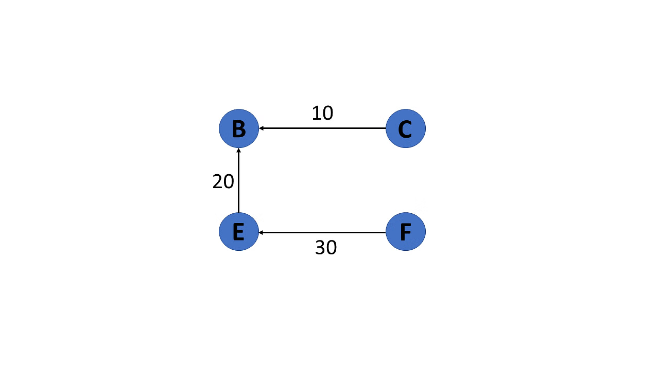
Types of Graph
Directed Acyclic Graph: It's also known as a directed acyclic graph (DAG), and it's a graph with directed edges but no cycle. It represents the edges using an ordered pair of vertices since it directs the vertices and stores some data.

Slide 18
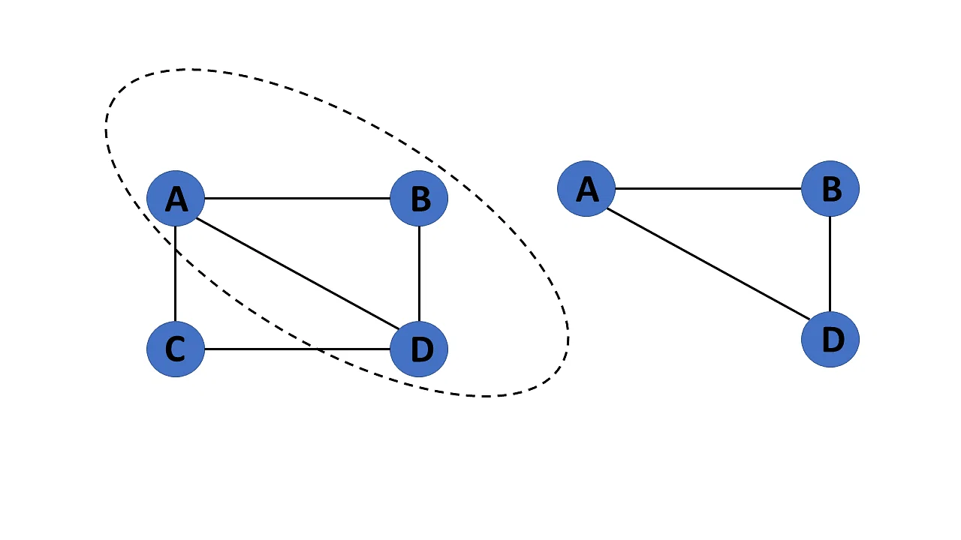
Types of Graph
Subgraph: The vertices and edges of a graph that are subsets of another graph are known as a subgraph.

Slide 19
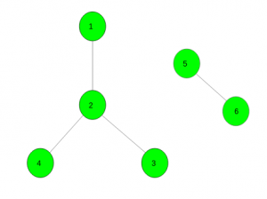
Types of Graph
Disjoint Graph: A graph is disjoint if it is not connected

Slide 20
Graph Representation
In graph data structure, a graph representation is a technique to store graph into the memory of computer.
There are 2 ways
Adjacency Matrix
Adjacency List

Slide 21
Adjacency Matrix
An Adjacency Matrix is a 2D array of size V x V where V is the number of nodes in a graph.
It is used to represent a "finite graph", with 0's and 1's.
The elements of the matrix indicates whether pairs of vertices are adjacent or not in the graph
Each cell in the above matrix is represented as Aij, where i and j are nodes. The value of Aij is either 1 or 0 depending on whether there is an edge from vertex i to vertex j. If there is a node then, Aij= 1, otherwise Aij= 0

Slide 22
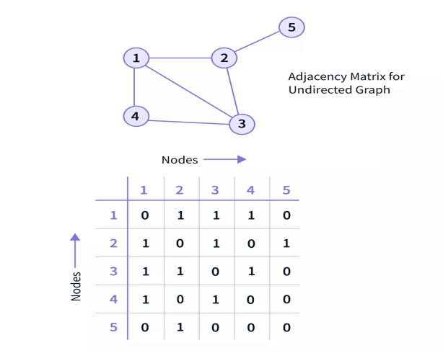
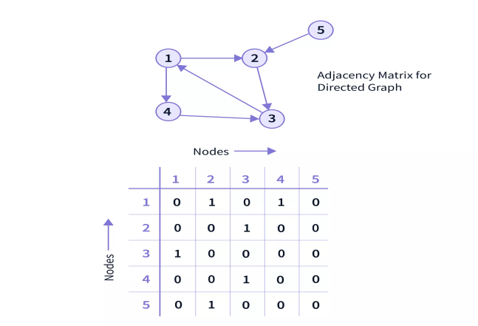
Adjacency Matrix
The adjacency Matrix for a directed graph also follows the same conventions
there is a '1' in the matrix if there is an edge pointing from one node to another, say from node A to node B. But vice versa may not be applicable.

Slide 23
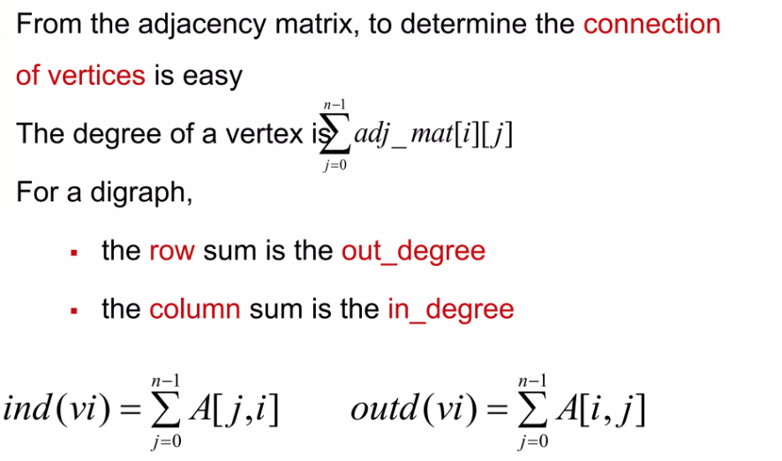
Advantages of using Adjacency Matrix

Slide 24
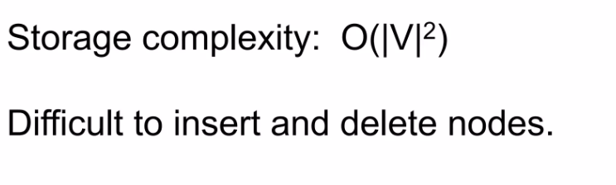
Disadvantages of using Adjacency Matrix

Slide 25
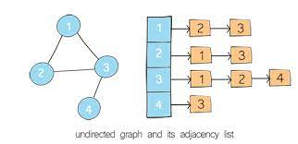
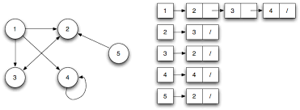
Adjacency List
Adjacency LIST
An adjacency list represents a graph as an array of linked lists.
The index of the array represents a node.
Each element in the linked list represents the nodes that are connected to that node by an edge.

Slide 26
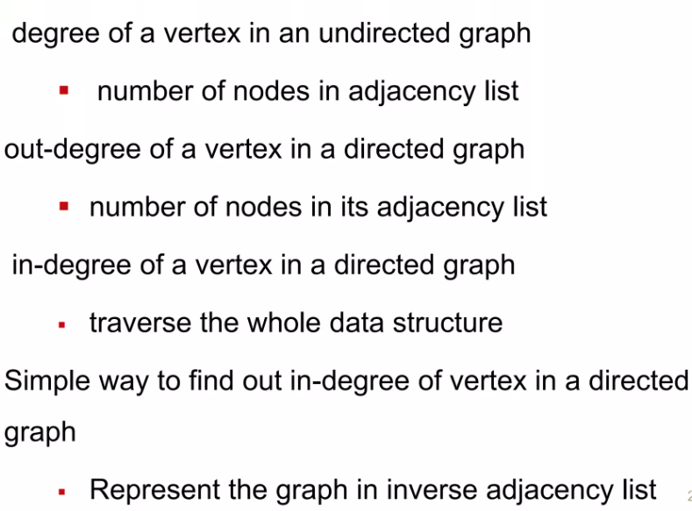
Advantages of using Adjacency List

Slide 27
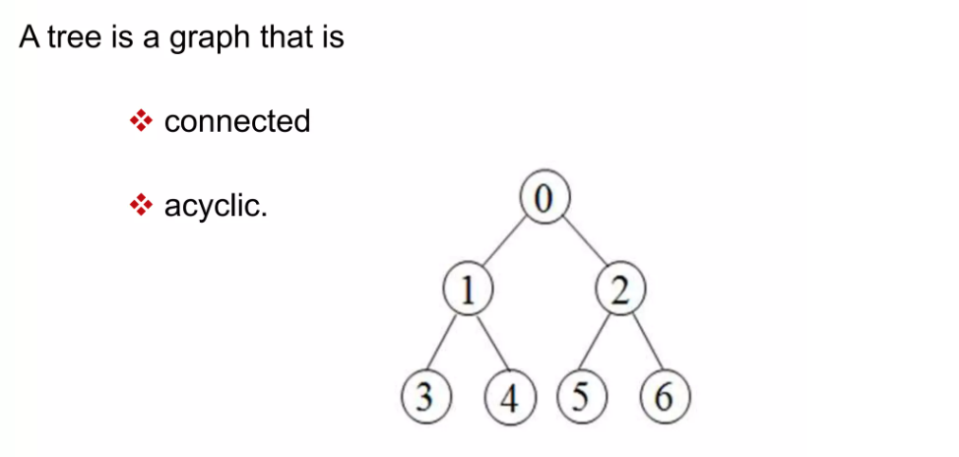
Tree as a Graph

Slide 28
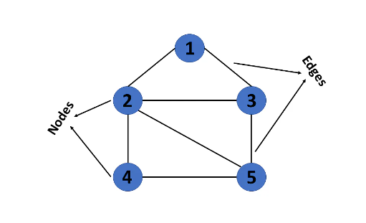
What is Graph Traversal
Traversing a graph means visiting each vertex in a graph.
Since a graph can contain cycles it might be possible that single vertex can be visited twice and can reduce the efficiency.
So it is very important to traverse the graph in such a way that each vertex must be visited only once.
Two techniques are proposed for such kind of graph traversal.
DFS (Depth First Search)
BFS (Breadth First Search)

Slide 29
DFS (Depth First Search)
Recursive algorithm to search (Traverse) all the vertices of a tree data structure or a graph.
Because of the recursive nature, stack data structure can be used to implement the DFS algorithm
A standard DFS implementation puts each vertex of the graph into one of two categories:
Visited
Not Visited
The purpose of the algorithm is to mark each vertex as visited while avoiding cycles.

Slide 30
DFS Traversal
Step 1: SET STATUS = 1 (ready state) for each node in G
Step 2: Push the starting node A on the stack and set its STATUS = 2 (waiting state)
Step 3: Repeat Steps 4 and 5 until STACK is empty
Step 4: Pop the top node N. Process it and set its STATUS = 3 (processed state)
Step 5: Push on the stack all the neighbors of N that are in the ready state (whose STATUS = 1) and set their STATUS = 2 (waiting state)
[END OF LOOP]
Step 6: EXIT

Slide 31
Pseudocode
DFS(G,v) ( v is the vertex where the search starts )
Stack S := {}; ( start with an empty stack )
for each vertex u, set visited[u] := false;
push S, v;
while (S is not empty) do
u := pop S;
if (not visited[u]) then
visited[u] := true;
for each unvisited neighbor w of u
push S, w;
end if
end while
END DFS()

Slide 32
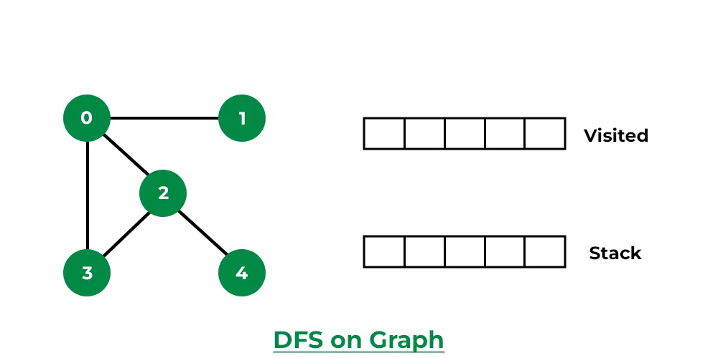
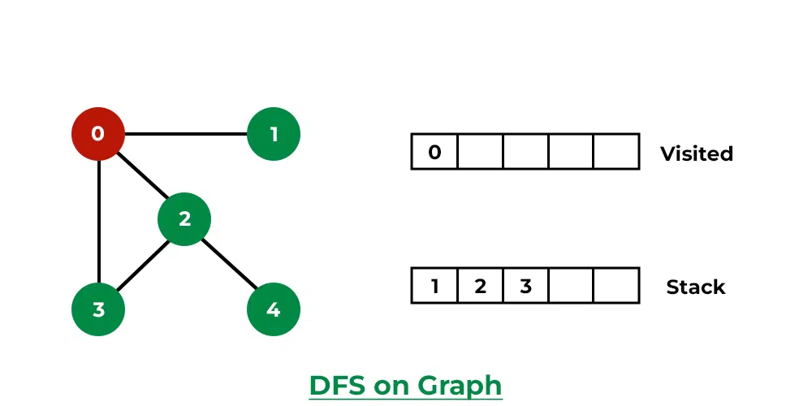
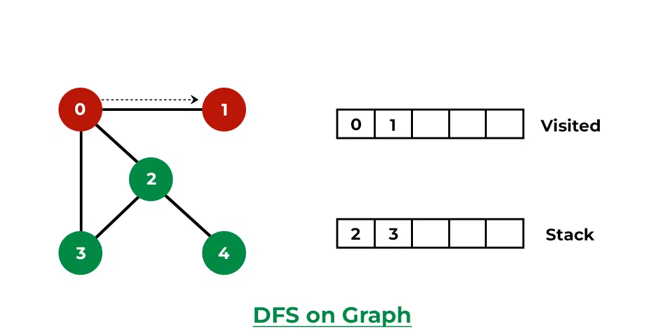
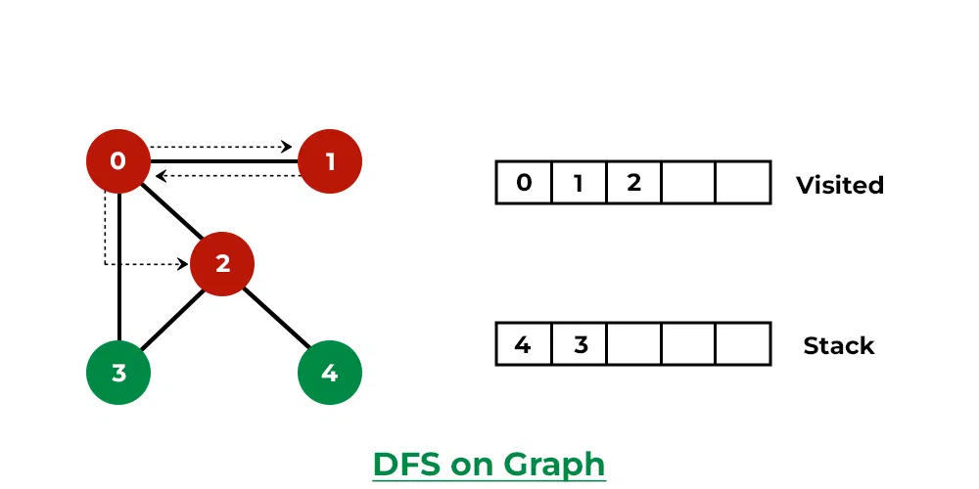
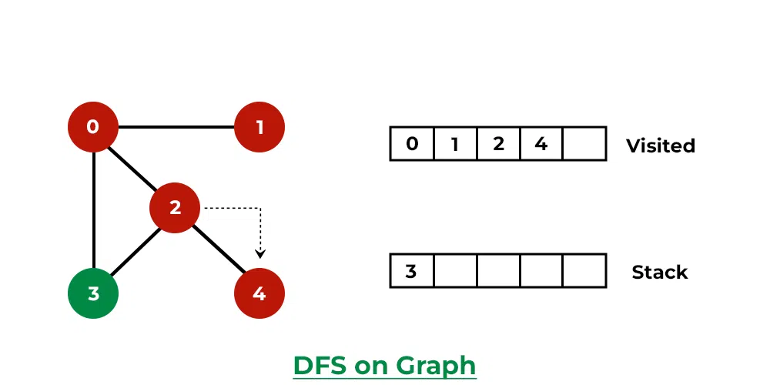
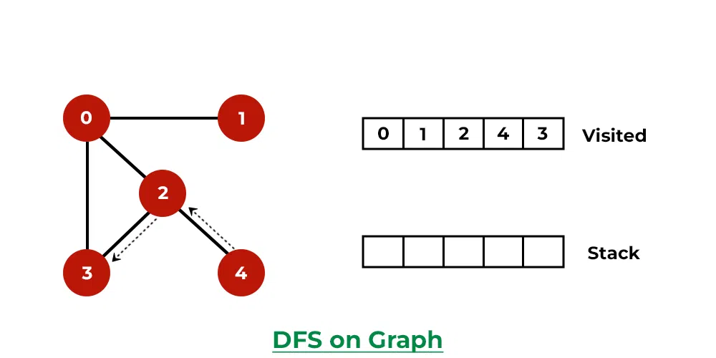
Example
1
2
3
4
5
6

Slide 33
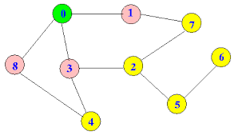
Example

Slide 34
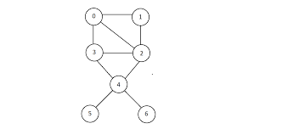
Example

Slide 35
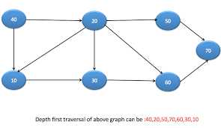
Example

Slide 36
Applications of DFS
For finding the path
To solve puzzles like maze
For finding the strongly connected components of a graph
For detecting cycles in a graph
In network topologies.

Slide 37
BFS (Breadth First Search)
It is a recursive algorithm to search all the vertices of a tree or graph data structure
puts every vertex of the graph into two categories - visited and non-visited.
It selects a single node in a graph and, after that, visits all the nodes adjacent to the selected node.

Slide 38
BFS Traversal
Step 1: SET STATUS = not visited (ready state) for each node in G
Step 2: Enqueue the starting node A and set its STATUS = Waiting
Step 3: Repeat Steps 4 and 5 until QUEUE is empty
Step 4: Dequeue a node N. Process it and set its STATUS =3 (Visited/Processed)
Step 5: Enqueue all the neighbors of N that are in the ready state (whose STATUS = 1) and set their STATUS = 2 (waiting state)
[END OF LOOP]
Step 6: EXIT

Slide 39
Pseudocode
BFS(G,v) ( v is the vertex where the search starts )
Queue Q := {}; ( start with an empty queue )
for each vertex u, set visited[u] := false;
enque Q, v;
while (Q is not empty) do
u := Deque Q;
if (not visited[u]) then
visited[u] := true;
for each unvisited neighbour w of u
enque Q, w;
end if
end while
END BFS()

Slide 40
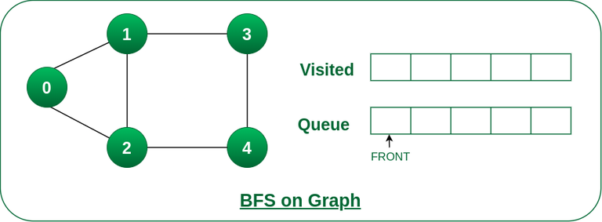
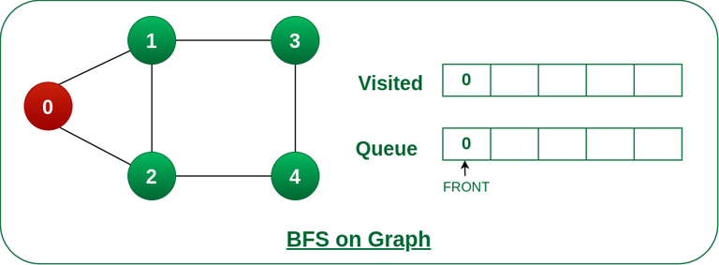
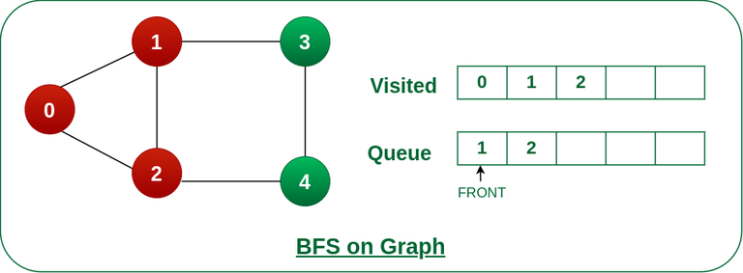
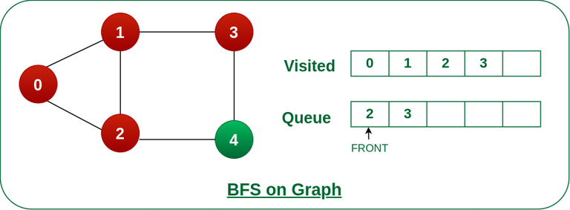
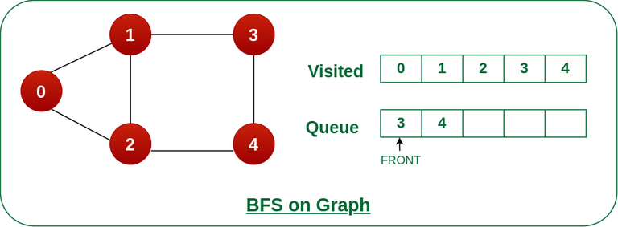


BFS Example
1
2
3
4
5
6
7

Slide 41
Example

Slide 42
Example

Slide 43
Example

Slide 44
BFS Applications
For GPS navigation
Path finding algorithms
In Ford-Fulkerson algorithm to find maximum flow in a network
Cycle detection in an undirected graph

Slide 45
BFS vs DSF
Parameters | BFS | DFS
Stands for | BFS stands for Breadth First Search. | DFS stands for Depth First Search.
Data Structure | BFS(Breadth First Search) uses Queue data structure for finding the shortest path. | DFS(Depth First Search) uses Stack data structure.
Definition | BFS is a traversal approach in which we first walk through all nodes on the same level before moving on to the next level. | DFS is also a traversal approach in which the traverse begins at the root node and proceeds through the nodes as far as possible until we reach the node with no unvisited nearby nodes.
Conceptual Difference | BFS builds the tree level by level. | DFS builds the tree sub-tree by sub-tree.
Suitable for | BFS is more suitable for searching vertices closer to the given source. | DFS is more suitable when there are solutions away from source.
Visiting of Siblings/ Children | Here, siblings are visited before the children. | Here, children are visited before the siblings.
Backtracking | In BFS there is no concept of backtracking. | DFS algorithm is a recursive algorithm that uses the idea of backtracking

Slide 46
BFS vs DSF
Optimality | BFS is optimal for finding the shortest path. | DFS is not optimal for finding the shortest path.
When to use? | When the target is close to the source, BFS performs better. | When the target is far from the source, DFS is preferable.

Slide 47
Applications of Graph
Graphs are used in computer science to depict the flow of computation.
Users on Facebook are referred to as vertices, and if they are friends, there is an edge connecting them. The Friend Suggestion system on Facebook is based on graph theory.
You come across the Resource Allocation Graph in the Operating System, where each process and resource are regarded vertically. Edges are drawn from resources to assigned functions or from the requesting process to the desired resource. A stalemate will develop if this results in the establishment of a cycle.
Web pages are referred to as vertices on the World Wide Web. Suppose there is a link from page A to page B that can represent an edge. This application is an illustration of a directed graph.
Graph transformation systems manipulate graphs in memory using rules. Graph databases store and query graph-structured data in a transaction-safe, permanent manner.
GPS systems and Google Maps use graphs to find the shortest path from one destination to another.

Slide 48
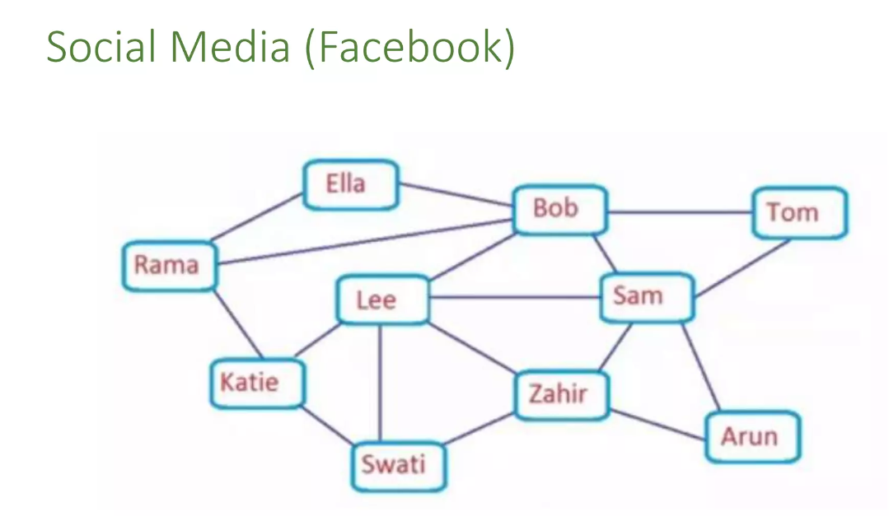
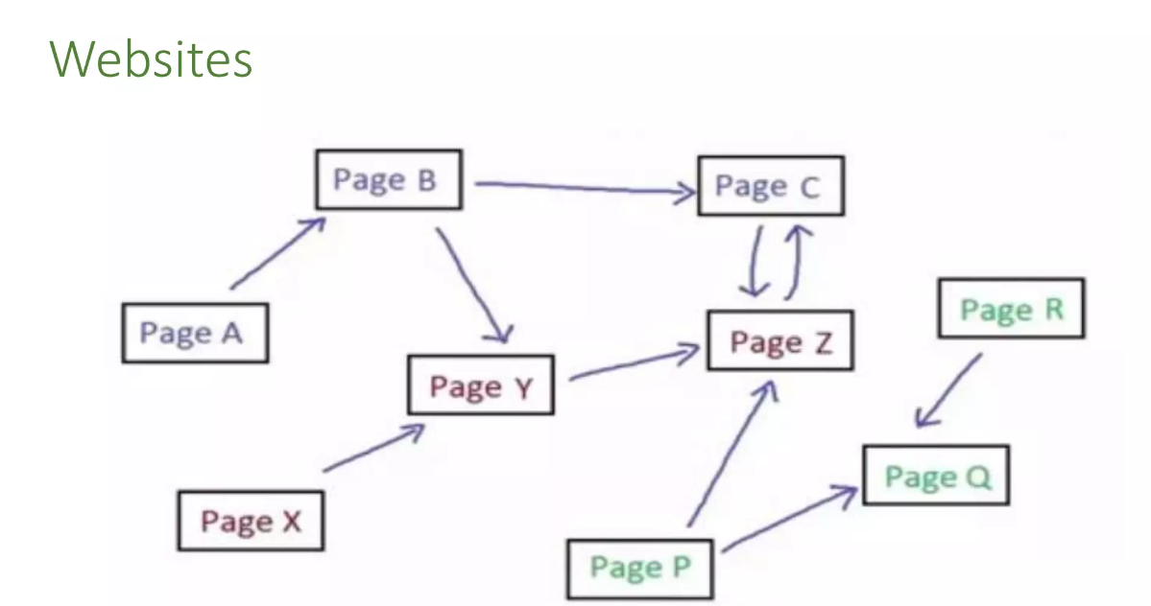
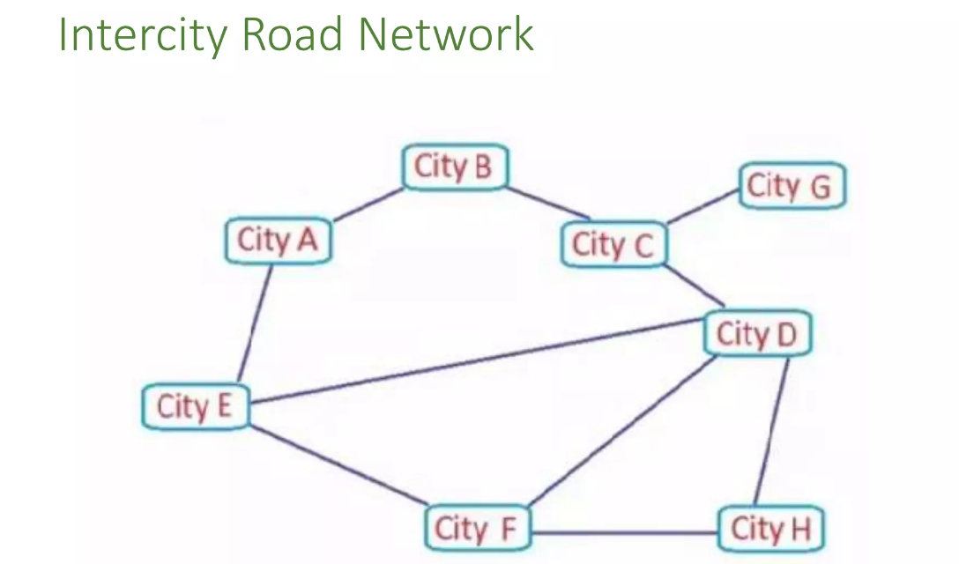
Applications of Graph

Slide 49

Applications of Graph

Slide 50
Shortest Path Algorithm
The shortest path problem is about finding a path between vertices in a graph such that the total sum of the edges weights is minimum.
Dijkstra's Algorithm: Dijkstra's Algorithm works on the basis that any subpath B -> D of the shortest path A -> D between vertices A and D is also the shortest path between vertices B and D.

Slide 51
Dijkstra's Algorithm
Initialization:
D(s) : Shortest distance to s is set to 0
For all other vertices v D(v) is set to ∞
Priority Queue PQ is constructed which is initially holds all the vertices of graph. Each vertex v have the priority D(v)
Pick up the first minimum element from the priority queue PQ
For all the vertices adjacent to s
Check if the edge from s->v gives shortest path
if (D(s) + weight of edge s->v) < D(v)
D(v)= D(s) + weight of edge s->v
Pick the next element from Priority queue PQ and repeat the process until PQ is empty

Slide 52

Dijkstra's Algorithm

Slide 53

Dijkstra's Algorithm

Slide 54

Dijkstra's Algorithm

Slide 55

Dijkstra's Algorithm

Slide 56





Minimum Spanning Tree
What is a Spanning Tree?
A spanning tree is a sub-graph of an undirected connected graph, which includes all the vertices of the graph with a minimum possible number of edges. If a vertex is missed, then it is not a spanning tree.

Slide 57





Minimum Spanning Tree
Minimum Spanning Tree
A minimum spanning tree is a spanning tree in which the sum of the weight of the edges is as minimum as possible.

Slide 58
Kruskal’s Algorithm
Sort all the edges in ascending order of their weight
Pick the edge with the lowest weight and add it to the spanning tree. If adding the edge created a cycle, then reject this edge.
Repeat step 2 until there are (v-1) edges in the spanning tree

Slide 59

Kruskal’s Algorithm

Slide 60

Kruskal’s Algorithm

Slide 61

Kruskal’s Algorithm

Slide 62

Kruskal’s Algorithm

Slide 63
Prim’s Algorithm
Initialize visited array to 0
Count=0
While count < vertices
If newVertex is not visited
Mark newVertex as visited
Push all its edges to priority Queue
Extract the minimum edge from priority queue
If the minimum edge leads to an unvisited vertex add it to Minimum spanning tree
Current=newVertex
Count++
Else
Extract the minimum edge from priority again
If the minimum edge leads to an unvisited vertex add it to Minimum spanning tree
Current=newVertex

